Slide 1

CISC 250 – Business Telecomm Networks
Application Layer Protocols
- World Wide Web & HTTP

Slide 2
Web and HTTP
First some jargon
Web page consists of objects
Object can be HTML file, JPEG image, Java applet, audio file,…
Web page consists of base HTML-file which includes several referenced objects
Each object is addressable by a URL
Example URL:
www.someschool.edu/someDept/pic.gif
host name
path name

Slide 3
HTTP overview
HTTP: hypertext transfer protocol
Web’s application layer protocol
client/server model
client: browser that requests, receives, “displays” Web objects
server: Web server sends objects in response to requests
HTTP 1.0: RFC 1945
HTTP 1.1: RFC 2068S
HTTP 2.0
HTTP request
PC running
Explorer
HTTP response
HTTP request
Web
Server
(Apache
Microsoft IIS
Netscape ES
…)
HTTP response
Mac running
Navigator

Slide 4
HTTP request message
two types of HTTP messages: request, response
HTTP request message:
ASCII (human-readable format)
GET /somedir/page.html HTTP/1.1
Host: www.someschool.edu
User-agent: Mozilla/4.0
Connection: close
Accept-language:fr
(extra carriage return, line feed)

Slide 5
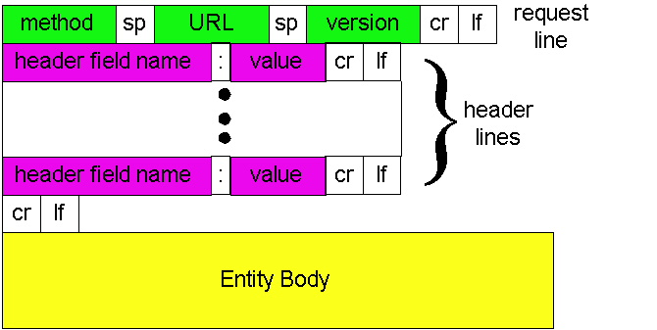
HTTP request message: general format

Slide 6
Uploading form input
Post method:
URL method:

Slide 7
Method types
HTTP/1.0
GET//retrieve
POST//add-in
HEAD
HTTP/1.1
GET, POST, HEAD
PUT//update
DELETE//delete

Slide 8
HTTP response message
HTTP/1.1 200 OK
Connection close
Date: Thu, 06 Aug 1998 12:00:15 GMT
Server: Apache/1.3.0 (Unix)
Last-Modified: Mon, 22 Jun 1998 …...
Content-Length: 6821
Content-Type: text/html
data data data data data ...

Slide 9
HTTP response status codes
In first line in server->client response message.
A few sample codes:
200 OK
Request succeeded ,request object later in this message
301 Moved Permanently
request object moved
400 Bad Request
typo
404 Not Found
505 HTTP Version Not Supported

Slide 10
Trying out HTTP (client side)
1. Telnet to your favorite Web server:
telnet
2. Type in a GET HTTP request:
GET
Host:
3. Look at response message sent by HTTP server!

Slide 11
Downloading a Complex Webpage with Two Graphics Files
HTML Document
HTML Document
Browser
Webserver
Application
Client PC
2
Graphics
Files
Webserver
As
Displayed

Slide 12


